Slide 1
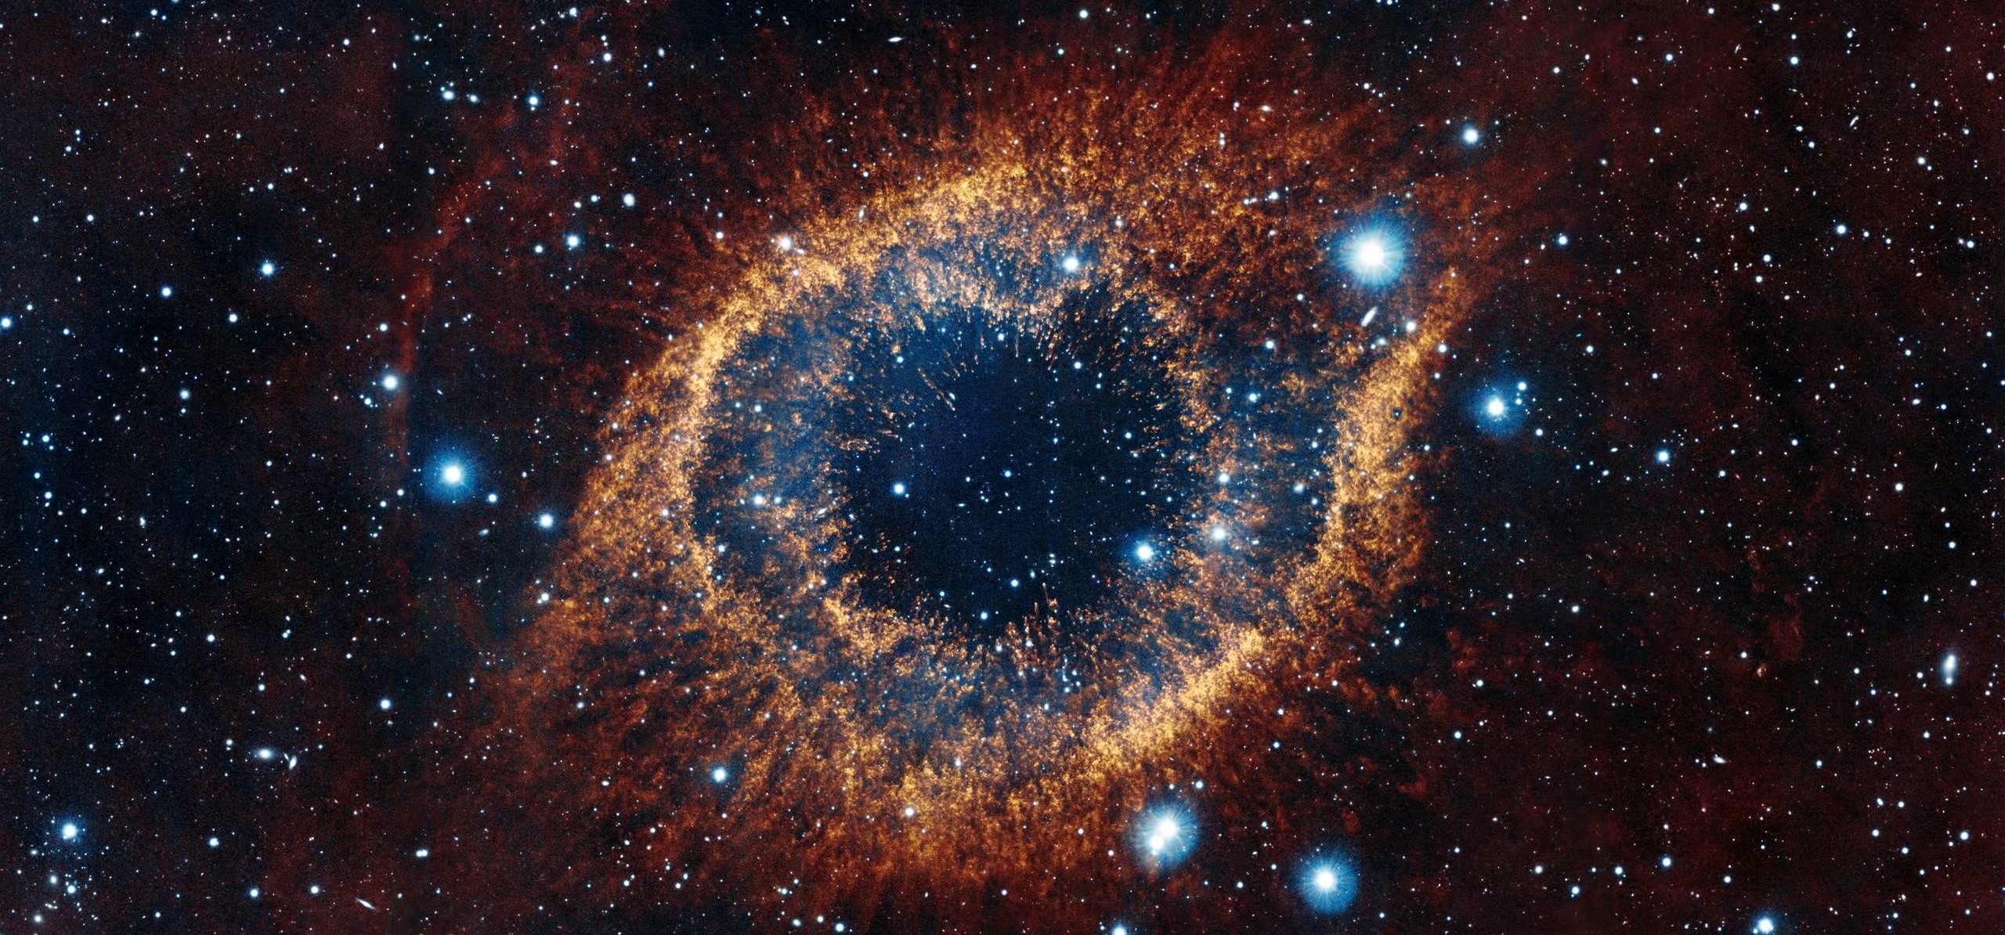
Mai Ngo Advanced ML
Final Project Presentation Astrophysical Object
Photometric Classification
3.18.2024

Slide 2
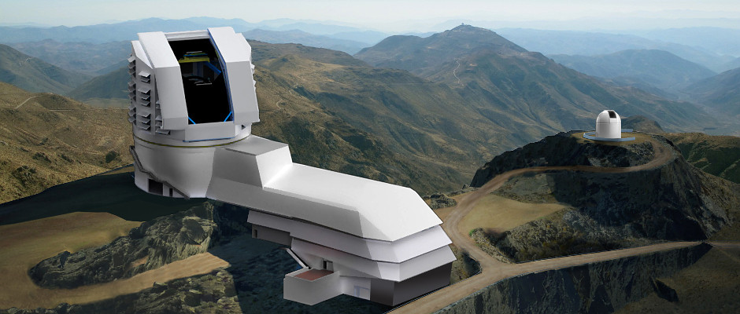
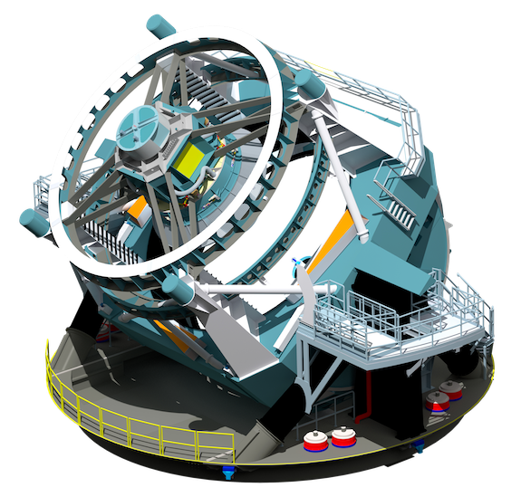
agenda
Large-aperture Synoptic
Survey Telescope (LSST) Data
Data Introduction
Visualization
Data Construction
Class Imbalance (Down Sampling)
Classification Models
Random Forest
Gradient Boosting
SVM
Neural Network
Best Model
Conclusions & Takeaways

Slide 3
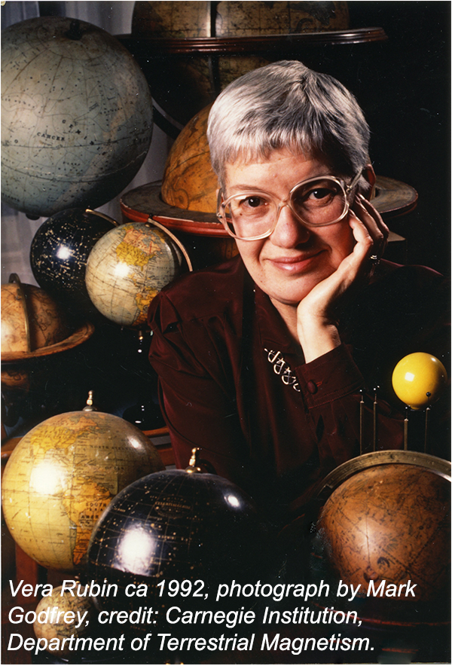
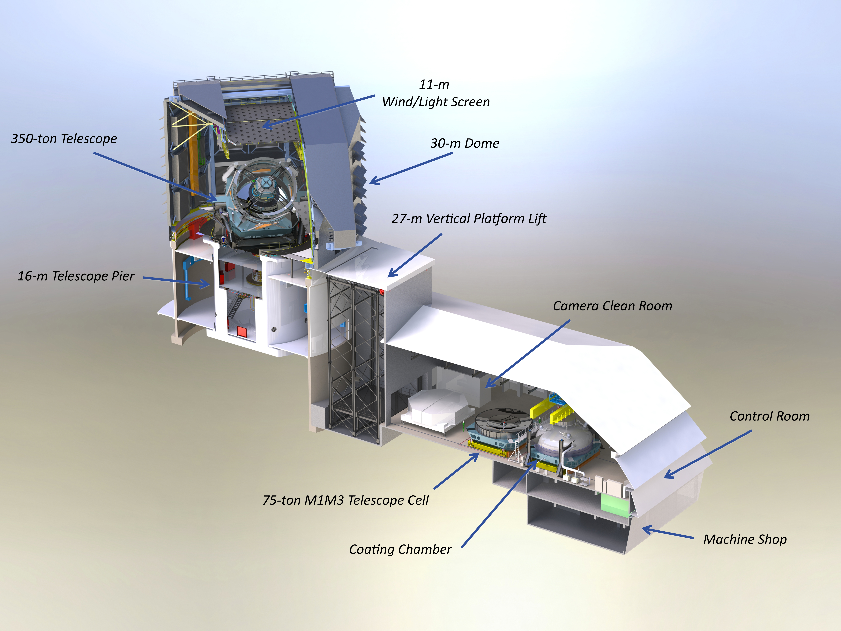
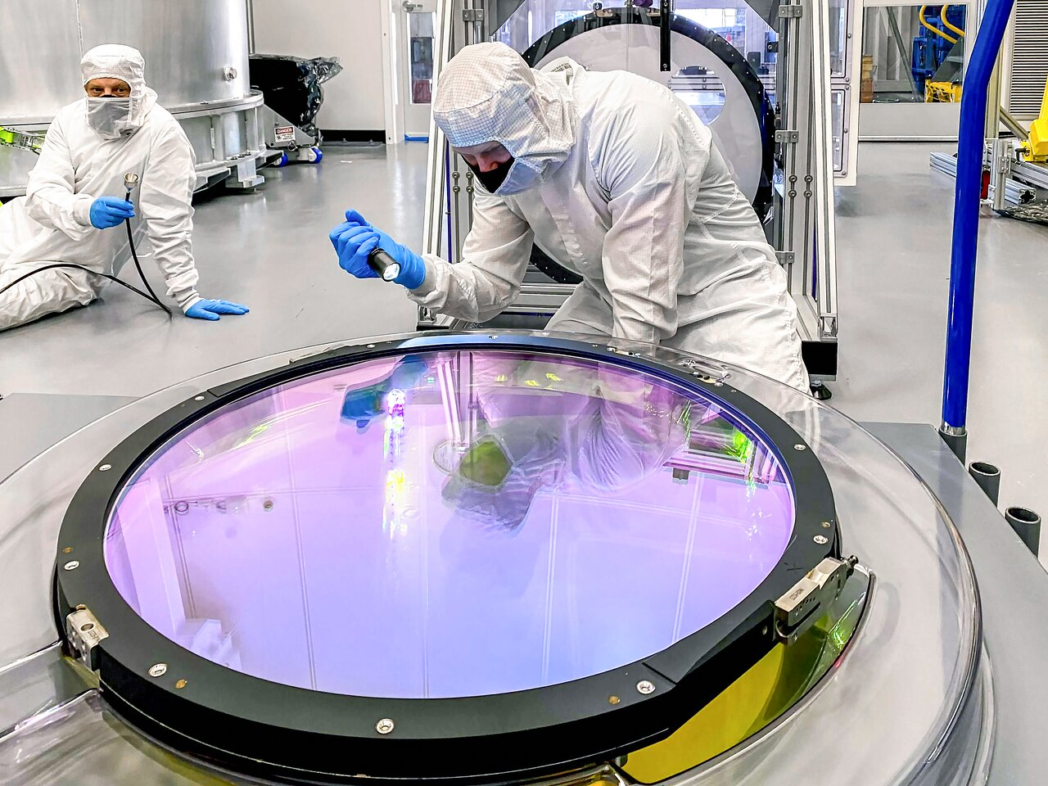
Large-aperture Synoptic Survey Telescope (LSST)
agenda
LLST : A highly efficient optical telescope observes activities of near-Earth astrophysical objects.
Location: Vera C. Rubin Observatory in Chile
Notes:
Can categorizes up to 90% (between 60-90%) and assess potential asteroids threat to life on Earth.
Dr. Vera C. Rubin was an American astronomer. Her amazing legacy life-work strongly focuses on finding profound evidence on the existence of unseen "dark" matter in the Cosmo.

Slide 4
LSST Data introduction
object_id: Object identifier.
ra: right ascension | decl: declination.
gal_l: Galactic longitude | gal_b: Galactic latitude
ddf: Flag if object in the Deep Drilling Fields survey.
hostgal_specz: Spectroscopic redshift.
hostgal_photoz: Photometric redshift.
hostgal_photoz_err: Uncertainty on hostgal_photoz.
distmod: Distance to the objects.
mwebv: Extinction of light due to Milky Way dust .
target: 14 classes.
[6, 15, 16, 42, 52, 53, 62, 64, 65, 67, 88, 90, 92, 95]
Meta Data - Obs: 7,848 | Features: 12
Time Series Data - Obs:1,421,705 | Features: 6
object_id: Object identifier.
mjd: Time of the observation.
passband: The specific LSST passband.
flux: Measures brightness in the passband of observation.
flux_err: Uncertainty on flux.
detected: Flag if object's brightness exhibits statistically significant.
Multiple object_id under ONE target class!

Slide 5
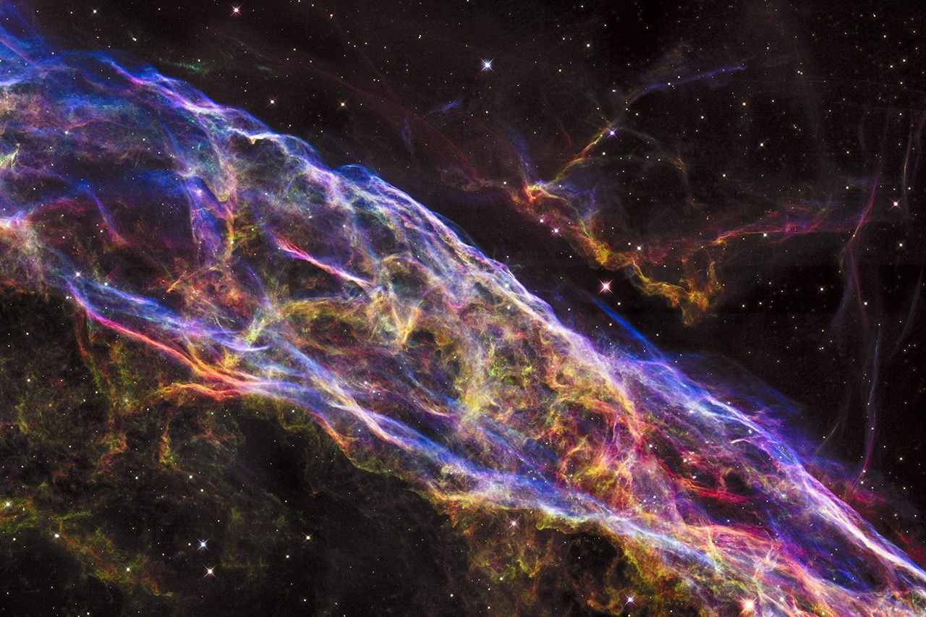
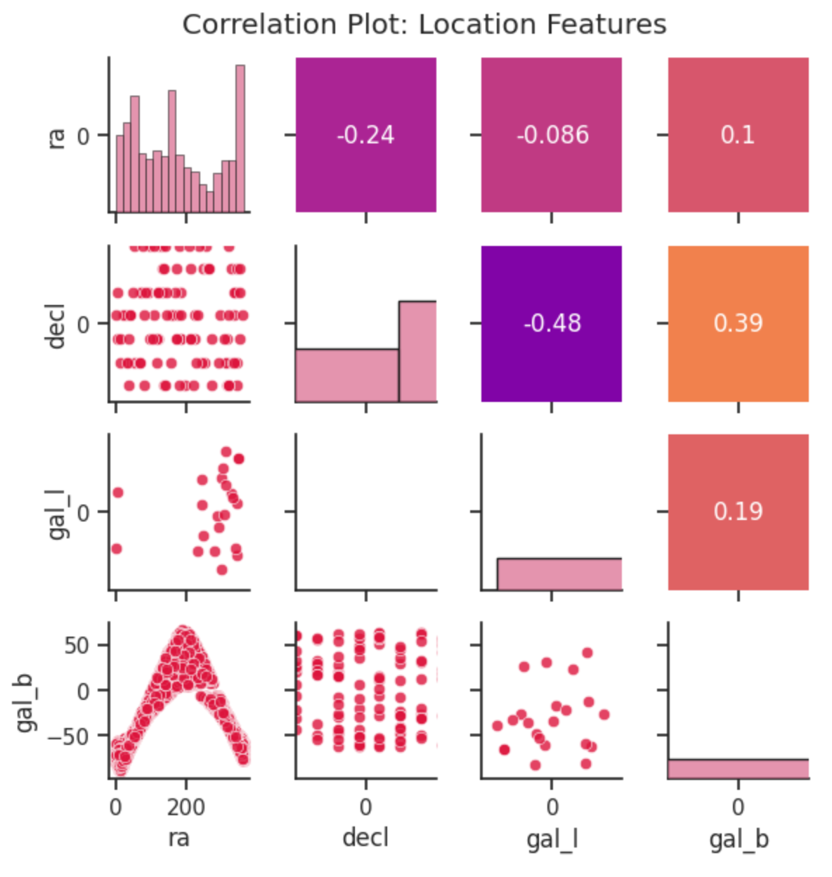
Data VISUALIZATION
– META DATA

Slide 6
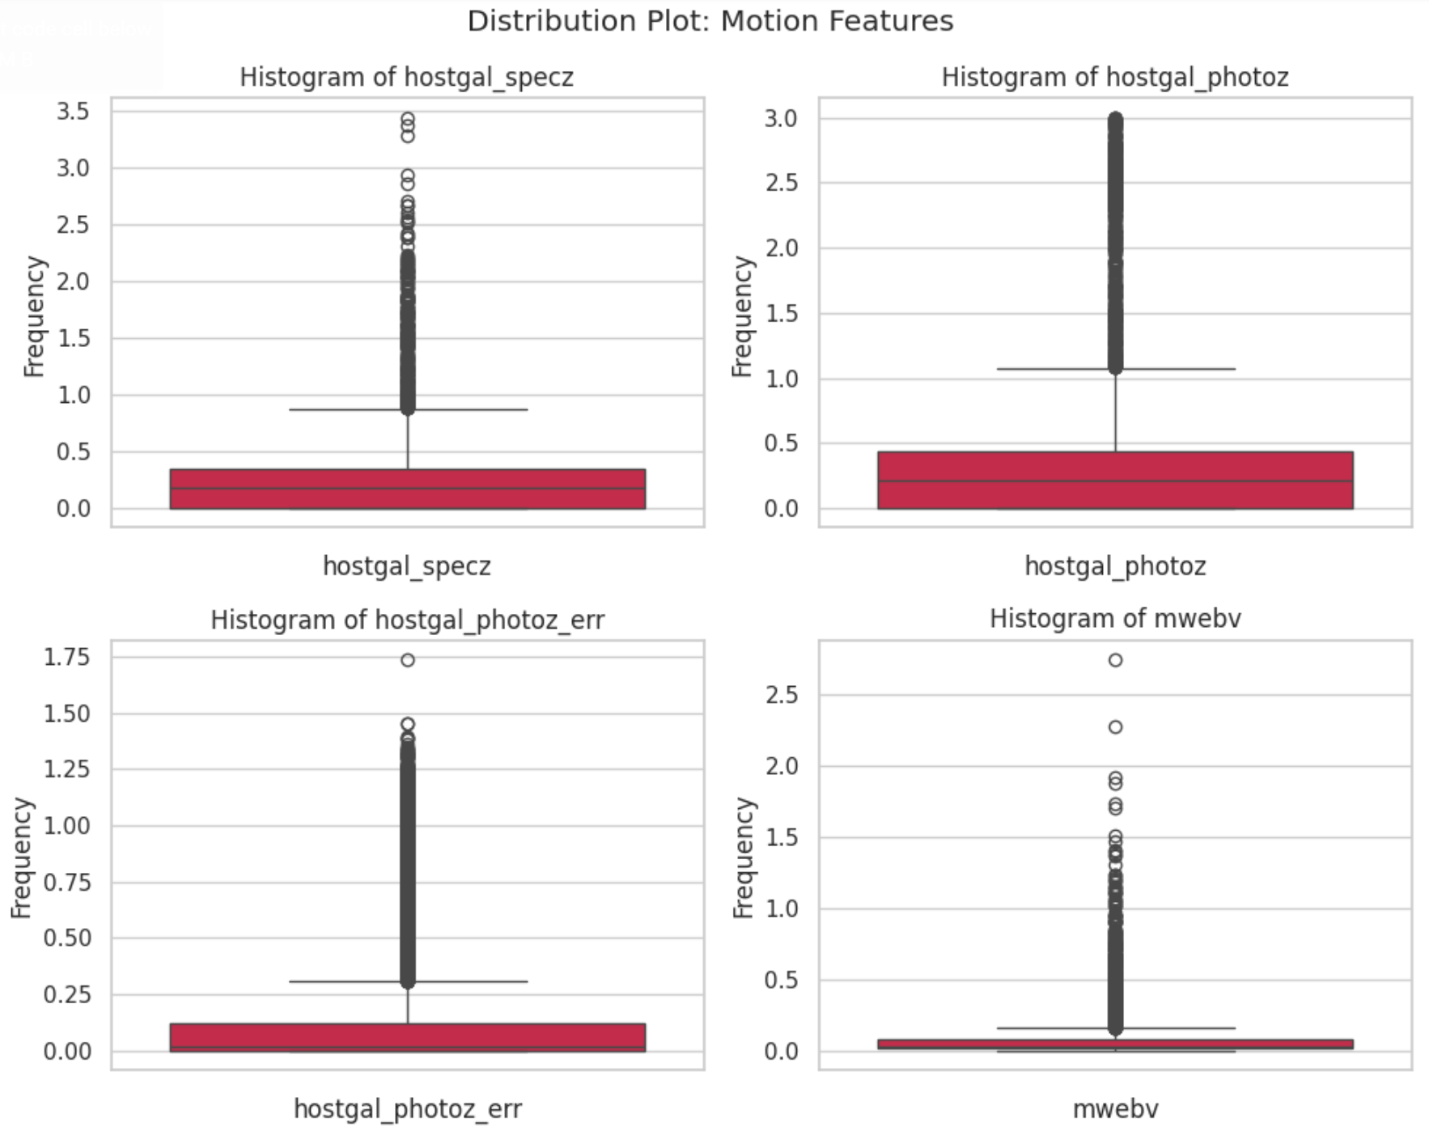
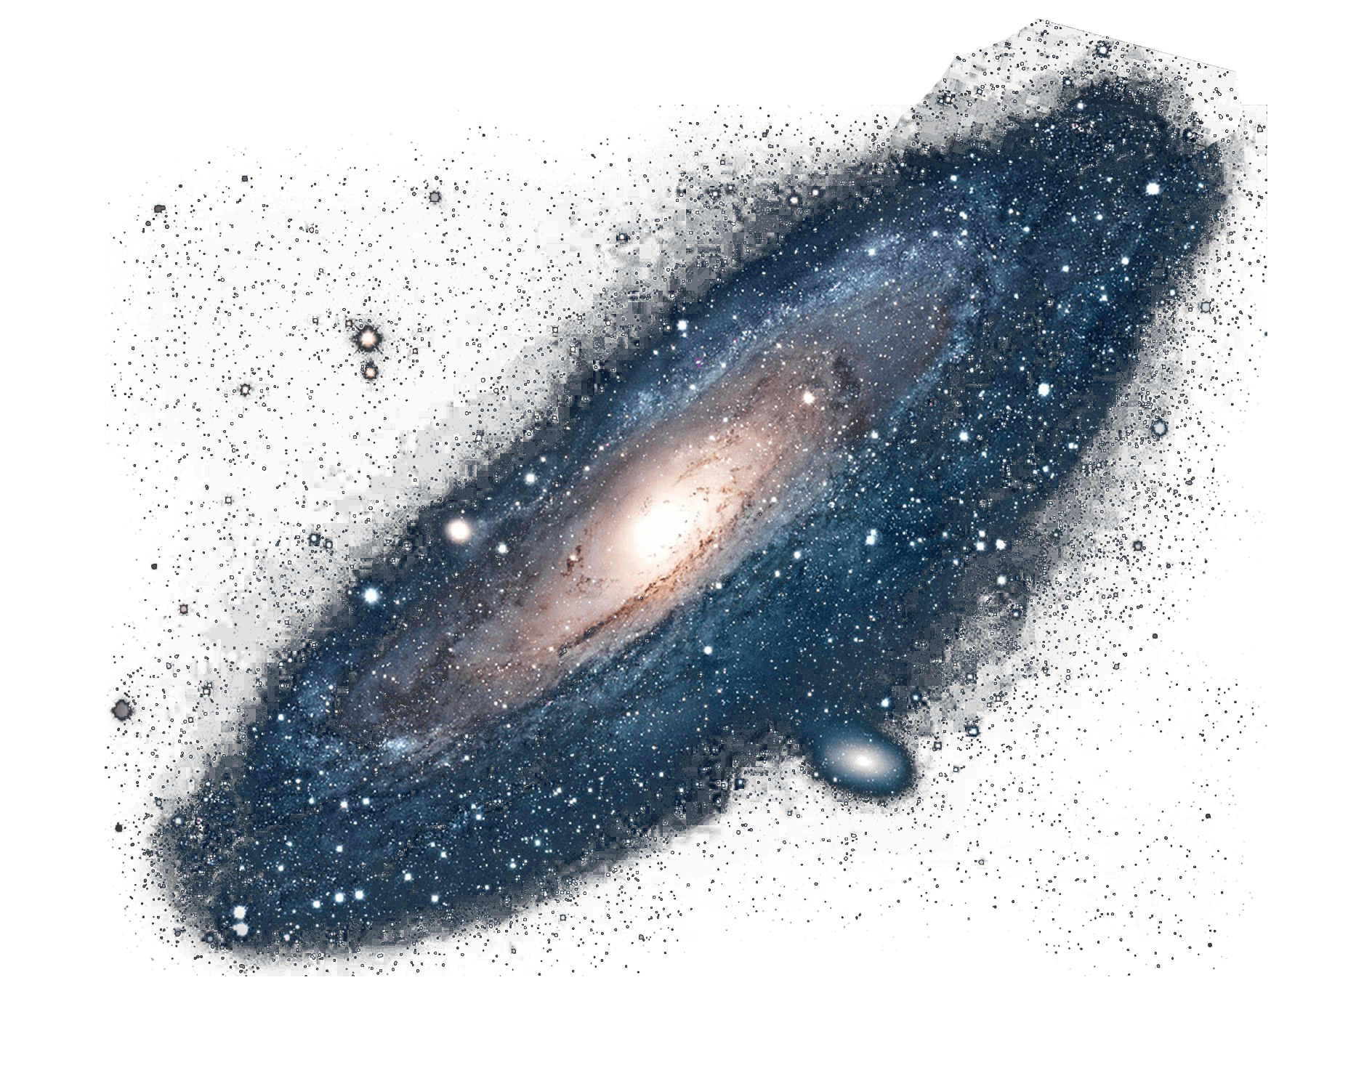
Data VISUALIZATION – META DATA

Slide 7
Passband | Flux ?
Data VISUALIZATION–TIME SERIES DATA

Slide 8
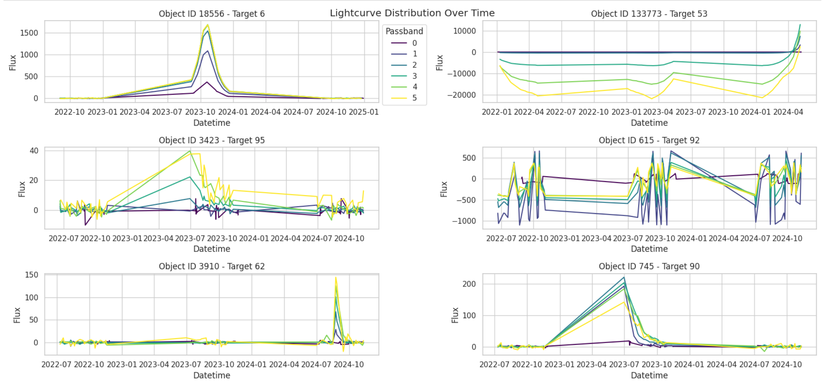

Data VISUALIZATION–TIME SERIES DATA

Slide 9
Apply Time Rolling (1 feature | 2 time-steps)
Objective: Merged dataset contains both static numerical & time series data!
Sequences of uniform length.
-> Each object must have the same observation time range.
Date | Temp (º C)
01/01/24 | 35
01/02/24 | 36
01/03/24 | 37
01/04/24 | 38
Date | Temp_t1 | Temp_t2
01/01/24 | 35 | 36
01/02/24 | 36 | 37
01/03/24 | 37 | 38
01/04/24 | 38 | NaN
Data
CONSTRUCTION
*Features drop as well.
Notes:
Capture time and relationships patterns of an object given consecutive observed time points. Past observations often influence future values.

Slide 10
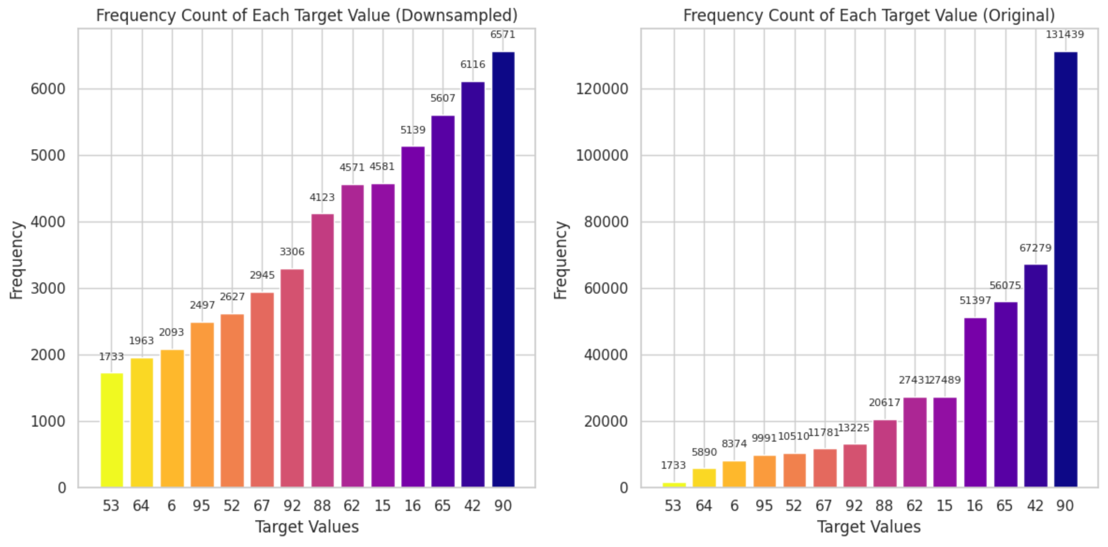
Class Imbalance (Down Sampling)

Slide 11

Final data
Train-Test Split | 0.65 – 0.35
-> Ensure similar class distribution in both sets.
Feature Selection ONLY on static data.
Train Data:
Observations: 667, 725
Features: 18
Down Sampled Data:
Observations: 81,155
Features: 18
W ⬇
W ⬆

Slide 12

Random Forest
Gradient Boosting
Ada Boost
SVM
Neural Network
     CV
    
    
 
Top-down order!
: Parameter Tuning → Base ‘best’ Model.
■ : Feature Selection (FS) on Train Data.
● : Model FS with Train Data.
◆ : Base ‘best’ Model on Down-sampled Data.
★ : Model FS on Down-sampled Data.
CLASSIFICATION MODELS

Slide 13
Top-down order!
: Hyperparameter Tuning → Base ‘best’ Model.
■ : Feature Selection (FS) on Train Data.
● : Model FS with Train Data.
◆ : Base ‘best’ Model on Down-sampled Data.
★ : Model FS on Down-sampled Data.
SVM
Random Forest
     CV
CLASSIFICATION MODELS

Slide 14
Random Forest
Tune parameters: 'criterion': ['gini', 'entropy’]
Both with and without Cross-Validation gives the same outputs. Yet significantly difference in run time.
Model | Accuracy | Log Loss
Train Data | 0.97 | 1.05
Train Data (FS - 2) | 0.81 | 6.78
Down-sampled Data | 0.91 | 3.17
Down-sampled Data (FS -2) | 0.64 | 12.89

Slide 15
Gradient
boosting
Model | Accuracy | Log Loss
Train Data | 0.68 | 11.64
Train Data (FS - 2) | 0.65 | 12.55
Down-sampled Data | 0.65 | 12.53
Down-sampled Data (FS - 2) | 0.64 | 13.12
Tune parameters: 'criterion': ['friedman_mse', 'squared_error’]

Slide 16
Ada boost
Tune parameters: 'n_estimators': [20, 50, 100, 200],
'learning_rate': [0.01, 0.3, 0.5, 1.0]
Model | Accuracy | Log Loss
Train Data | 0.46 | 19.54
Train Data (FS - 3) | 0.31 | 24.74
Down-sampled Data | 0.23 | 7.78
Down-sampled Data (FS - 3) | 0.23 | 27.78

Slide 17
Model | Accuracy | Accuracy (weight) | Cross-entropy Loss
Down-sampled Data | 0.46 | 0.59 | 9.6
NEURAL NETWORK
1 LSTM layer for time series.
2 Dense layer for static.
Drop out rate = 0.2
Dense output layer | combine.

Slide 18
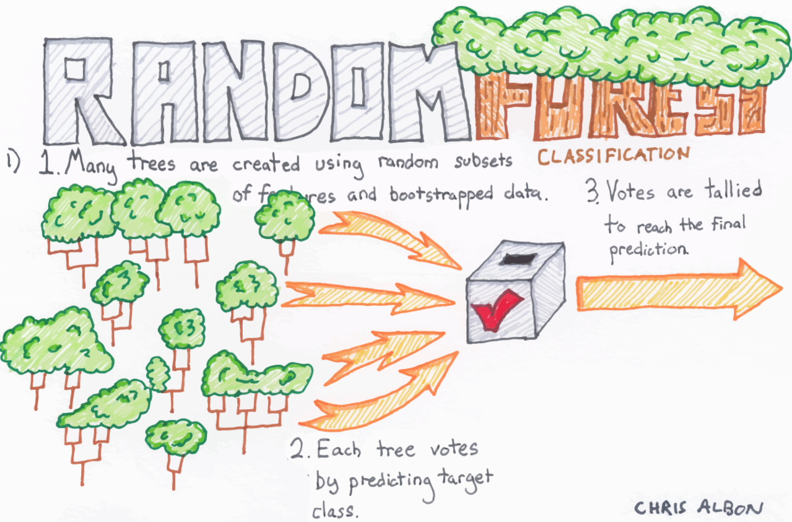


BEST MODEL?
 | Accuracy | Log Loss
Train Data | 0.97 | 1.05
Train Data (FS - 2) | 0.81 | 6.78
Down-sampled Data | 0.91 | 3.17
Down-sampled Data (FS - 2) | 0.64 | 12.89

Slide 19
IMPROVEMENT suggestions
t
Much more room for data pre-processing.
Time-series | Static Data.
Feature Engineering.
Class Imbalance.
Machine Learning Models | Neural Network.
Parameters Tuning.

Slide 20
Conclusion & takeaways
Enjoy working on this project.
Apply my knowledge from this course.
Learn about astrophysical objects and how telescope works!
Thank you!

